Slide 1
----- ----- Best Place For groceries warehouse ----- -----
Applied data science professional certificate
Vishal dhiman
(dvishal231995@gmail.com)

Slide 2
Introduction/ business problem:
There is a contractor who buys groceries from villagers and supplies it to the restaurants and other kind of places in Scarborough. Transporting groceries from long distance to different locations in Scarborough, costs more. So he thought he should build a warehouse in Scarborough near the restaurants and shops to whom he can deliver groceries so he can save his transportation money and time as well.

Slide 3
- Advantages of building warehouse near customers:
Building warehouse near his customers, can deliver them fresh items any time.
Cooks in restaurants can get fresh groceries early morning and starts cooking without waiting so long for the groceries.
There would be no delay in groceries delivery.
After supplying fresh items without any delay build customer’s trust.

Slide 4
- target audience
My analysis will educate someone who wants to build warehouse in the neighbourhood from where he can deliver the items to their customers quickly and saves lots of transportation money. It will give more business to the warehouse owner.
This analysis is also helpful to those who want to open new business like restaurants, bars or shops in the neighbourhood. They can check competition level in that neighbourhood or what is more popular in that neighbourhood and then decide which neighbourhood have more chances of profit for the business.

Slide 5
2. data:
As the contractor already made his mind to build warehouse in Scarborough, so for this we will need the data of location coordinates of the Scarborough and its neighbourhoods. Data like latitudes and longitudes of Scarborough and its neighbourhoods.
Firstly, we will find the neighbourhoods of Scarborough using the list of Postal Codes.

Slide 6
- Source for list of Postal codes :
“https://en.wikipedia.org/wiki/List_of_postal_codes_of_Canada:_M “
This website consists of a table that contains all the postal code of Canada with Borough and Neighbourhoods.
So by using python we will extract the data of that table and clean it to make it ready to use.

Slide 7
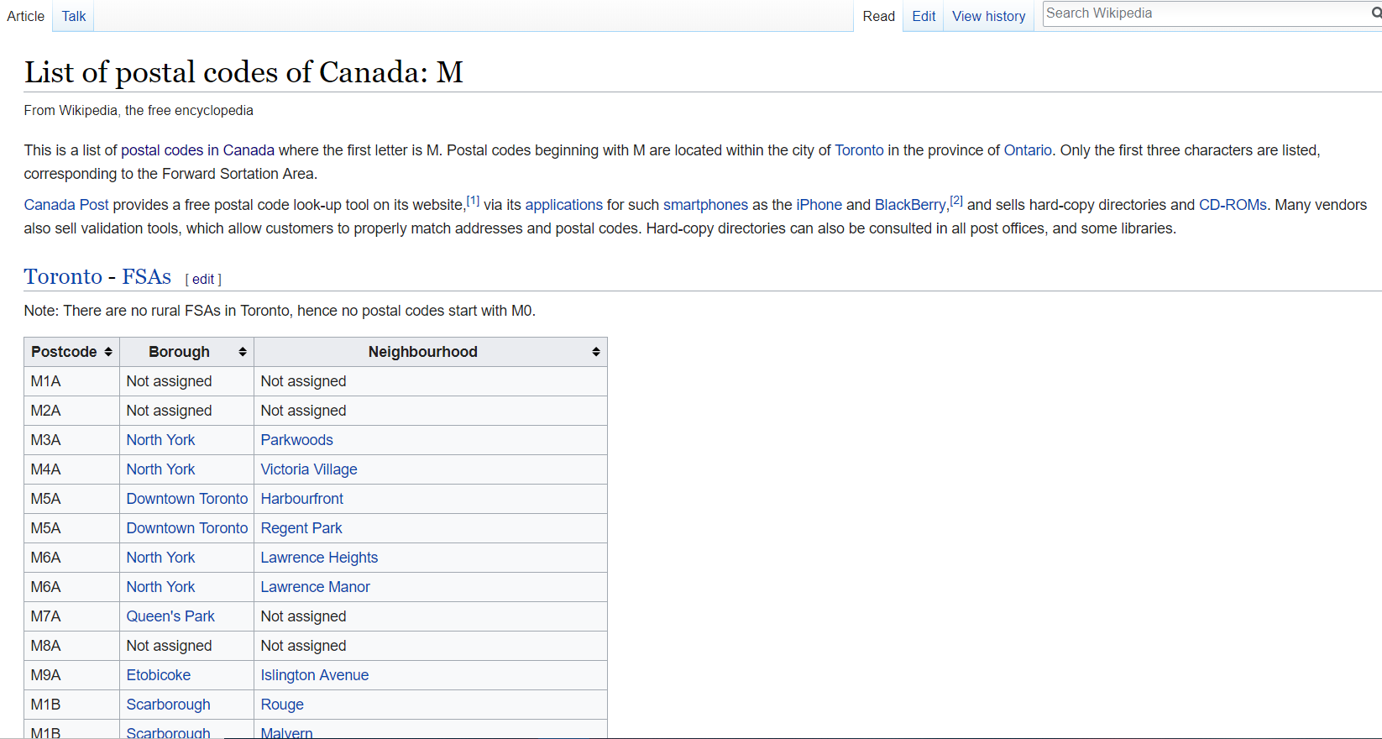
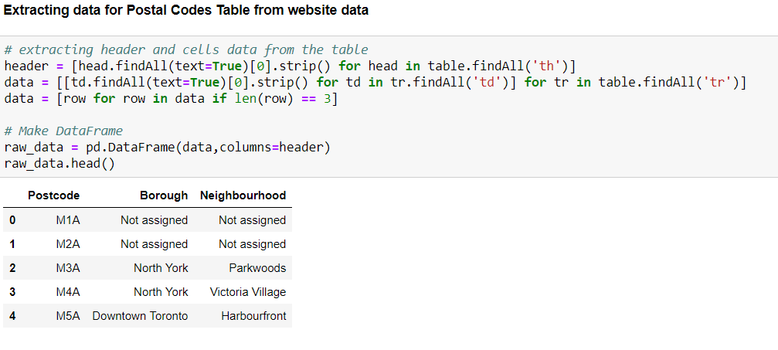
- Exporting table data from website into dataframe
-- Website Postal codes Table --
-- Dataframe with website table data --

Slide 8
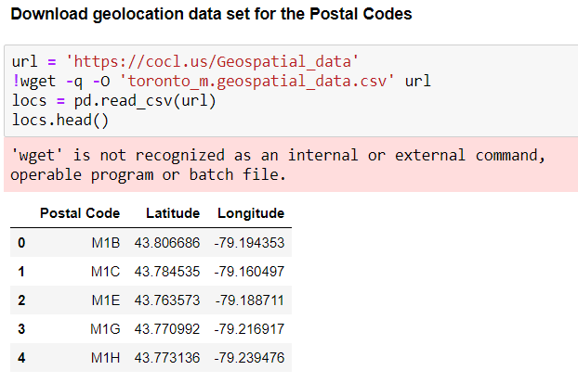
- Source for Neighbourhood locations data:
“https://cocl.us/Geospatial_data”
Then we will get the geolocation data of all the Neighbourhoods in “toronto_m.geospatial_data.csv” file from “https://cocl.us/Geospatial_data”.
This file contains Postal codes, latitudes and longitudes data.

Slide 9
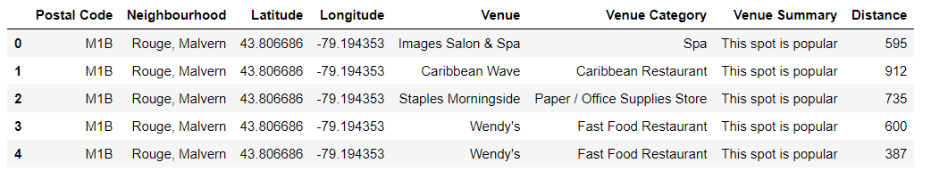
- Venues data using “foursquare” :
We also need the information of all the venues in each neighbourhood, and that information we can find using ‘Foursquare’. Foursquare will provide almost every information about the venues in the neighbourhood. And after cleaning the data we have data like this.

Slide 10
3. methodology:
In this section we will discuss about the data analysis that we did on the data extracted from the websites or internet and also which machine learning technique we used to get the best location for the groceries warehouse.
Filtering and cleaning of data.
Connecting to Foursquare to retrieve venues data for each neighbourhood.
Processing and cleaning of retrieved data.
Machine Learning technique used for finding best location for warehouse.

Slide 11
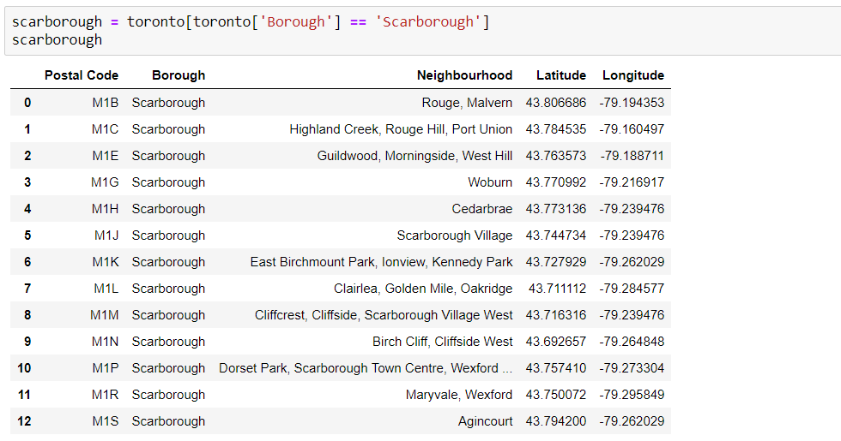
Filtering and cleaning of Data:
As the contractor already made his mind to build a warehouse in Scarborough, so we only selected the Scarborough data from the dataframe.

Slide 12
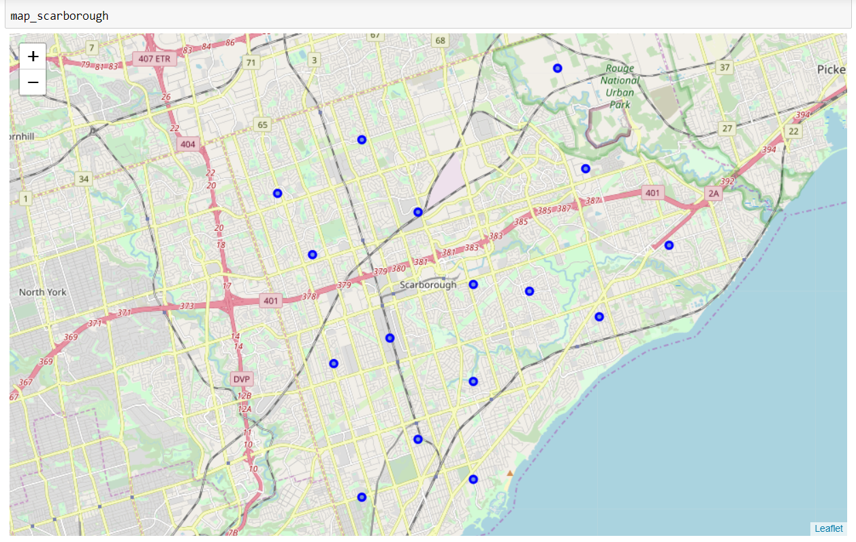
- Scarborough Map with its Neighbourhoods

Slide 13
Connecting to Foursquare to retrieve Venues Data:
Now we need the venues details for each neighbourhood.
After finding the list of neighborhoods, we then connect to the Foursquare API to gather information about venues inside each and every neighbourhood. For each neighbourhood, we have chosen the radius to be 1000 meter. It means that we have asked Foursquare to find venues that are at most 1000 meter far from the center of the neighbourhood. After cleaning, data would look like this.

Slide 14
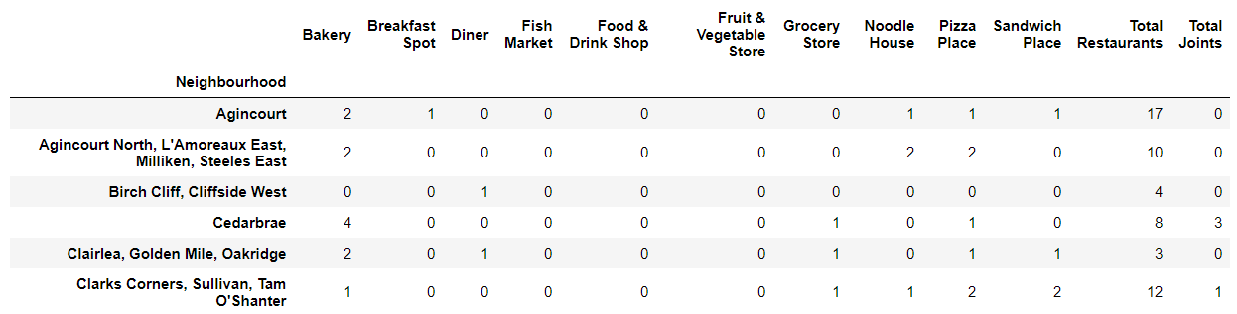
One Hot Encoding Process:
Now we will make dataframe of selected venues to whom contractor supplies groceries and then do encoding on “Venue Category” column using OneHot encoding process. This process will make different feature columns of Venue Category. After encoding we will integrate all restaurant columns to “Total Restaurant” column and all joint columns to ‘Total Joint” column. Now the dataset is ready for the Machine Learning Technique.

Slide 15
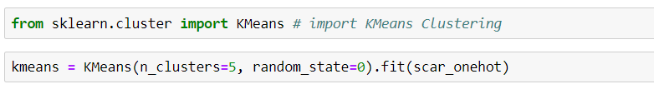
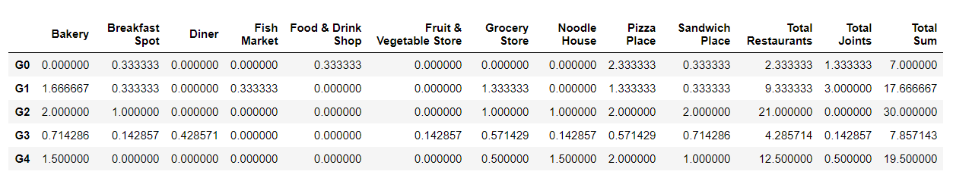
Machine Learning Technique (KMeans Clustering):
Now using KMeans Clustering, we will make 5 clusters. We selected only 5 clusters because we think 5 clusters are enough for our dataset. Then we will update our dataset with column names and index representing group or cluster. Also we will add new column “Total Sum” that stores the sum of all the venue category values of each group.
# KMeans Clustering

Slide 16
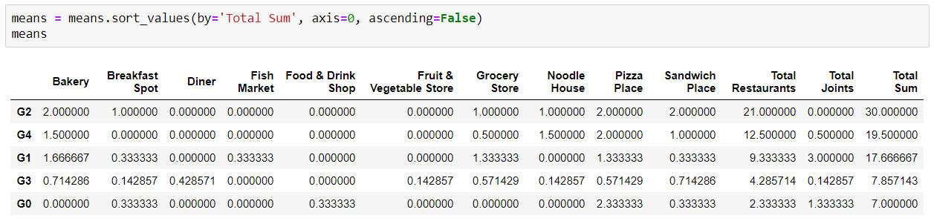
Sorting the DataFrame according to ‘Total Sum’ column.
After sorting the dataframe it shows that neighbourhoods falls under the ‘G2’ group are the best locations for building new Groceries Warehouse.

Slide 17
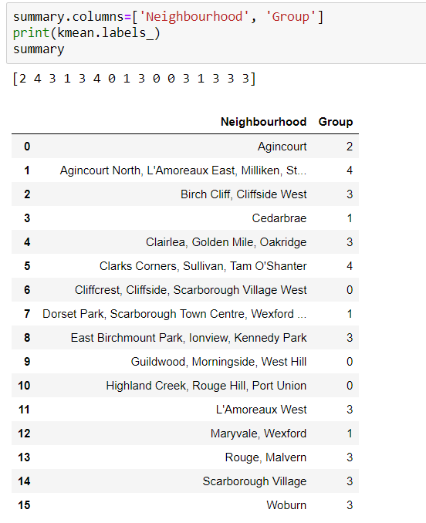
Neighbourhoods with there group number:

Slide 18
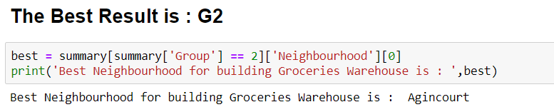
4. results:
After Machine Learning Technique; KMeans Clustering, we got our result.
And we found that Group ‘G2’ got the highest ‘Total sum’ value that means it is the nearest neighbourhood to most of the venues and having the highest chances of profit.
Best Neighbourhood is : Agincourt

Slide 19
Map of Scarborough including its Neighbourhoods in different colors representing different groups.
1st Best Neighbourhood in Green color.
2nd Best Neighbourhood in Blue color.
3rd Best Neighbourhood in Orange color.
4th Best Neighbourhood in Black color.
5th Best Neighbourhood in Red color.

Slide 20
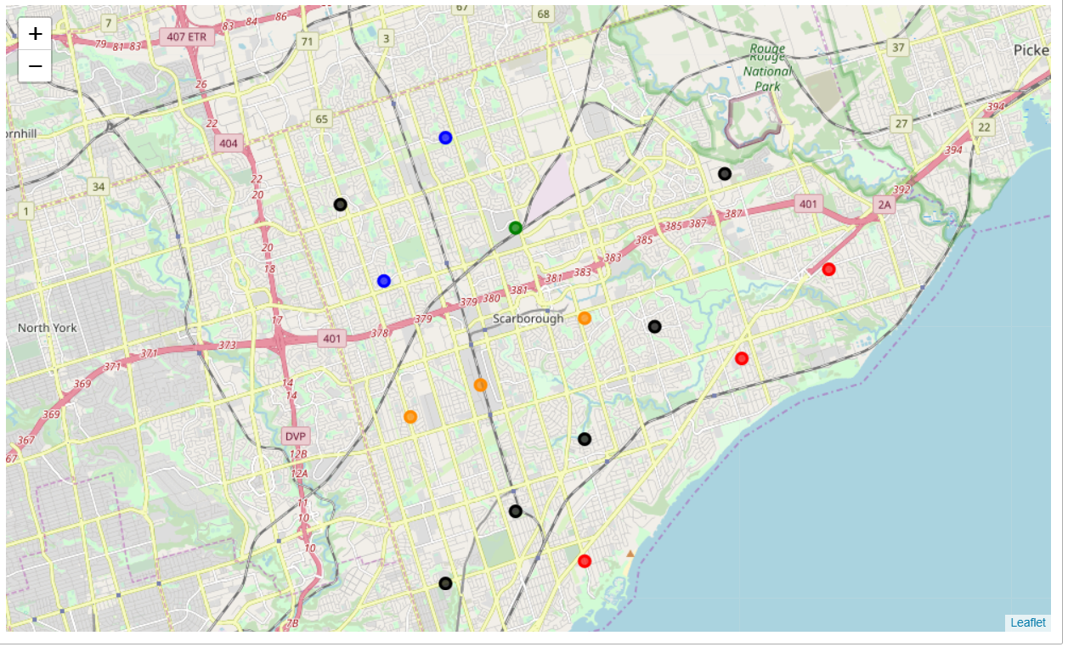
Map of Scarborough with its Neighbourhoods in different colors.

Slide 21
5. Conclusion:
We recommend groceries contractor to build his Groceries Warehouse in “Agincourt” neighbourhood for best results and profit.
Best Neighbourhood details:
Name: Agincourt
Latitude: 43.7942
Longitude: -79.262029

Slide 22
THANK YOU

